Slide 1
Raye's Adventure Tours
300986134 Parth Chandgadhiya
Let the fun begin!

Slide 2
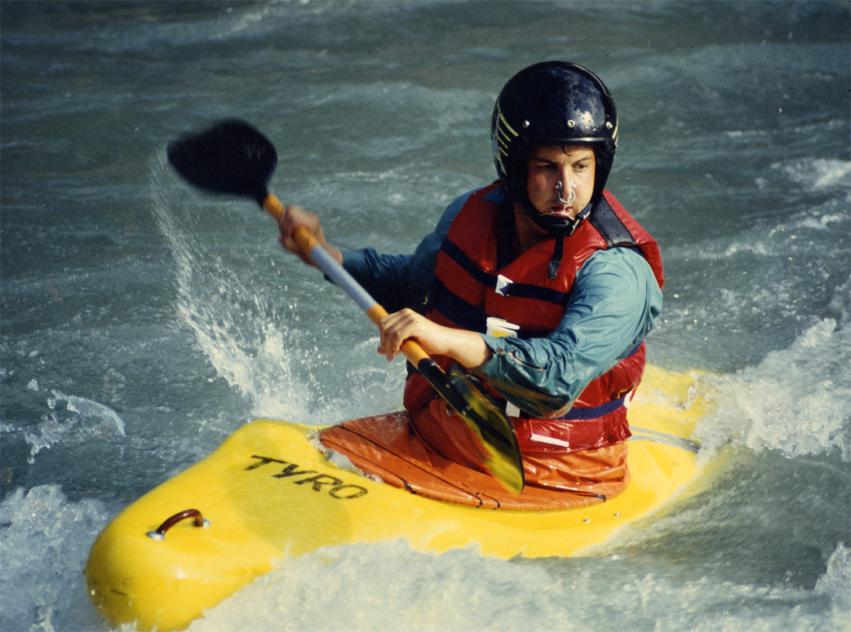
Coastal Kayaking
Half and full day tours
Sunset tours
Group tours
This Photo by Unknown Author is licensed under CC BY-SA

Slide 3
Hiking
We specialize in mountain hikes
Beginning to advanced
Experienced guides
Gear provided
Great snacks and meals

Slide 4
Horseback Riding
horse
rider
leader
English or Western
Gentle horses
Gear for all weather

Slide 5
Whitewater Rafting
Location | Length | Difficulty
Moose River | 9 miles | Level I
Farm River | 15 miles | Level III
Deer River | 5 miles | Level II

Slide 6
BOOK YOUR TOUR NOW!
Compare our rates
Check our guides
Our 30th year

